Slide 1

JAVASCRIPT
Let's Fast Forward your Journey to web development

Slide 2

What is JavaScript?
A high-level, interpreted programming language that adds interactivity to websites.
Runs primarily in web browsers (client-side) but also server-side with Node.js.
Dynamically typed (no need to declare variable types) and versatile.

Slide 3
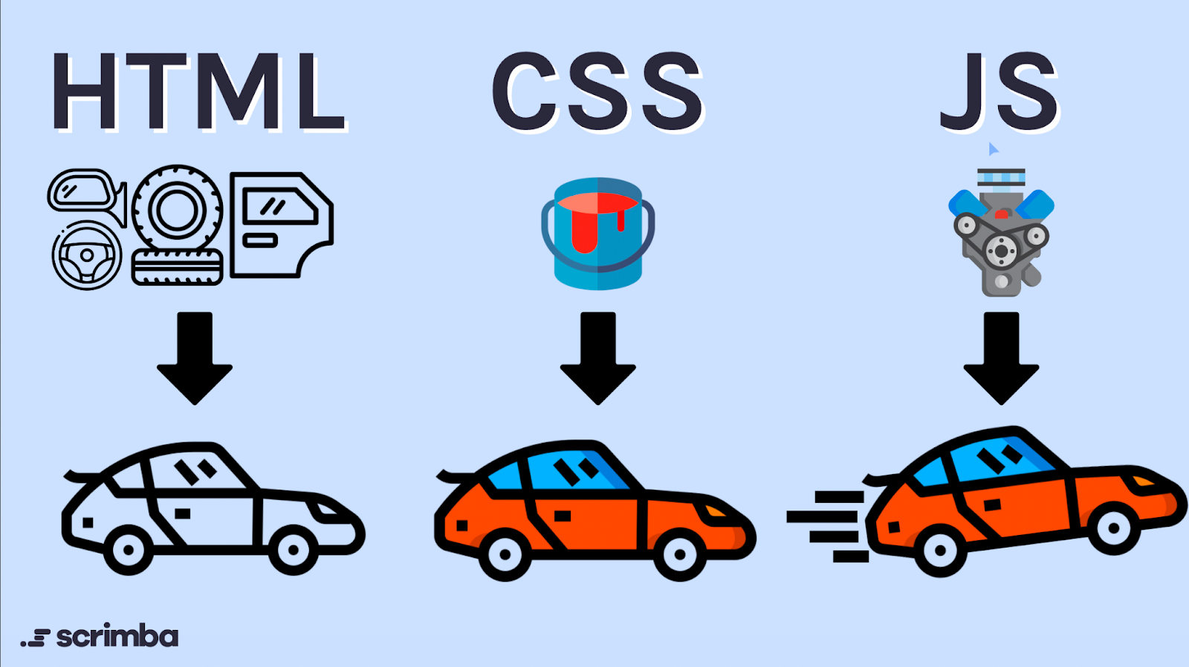
Core component of web development alongside:
HTML: Provides structure (e.g., headings, paragraphs).
CSS: Handles styling (e.g., colors, layouts).
JavaScript: Enables behavior (e.g., responding to user actions).

Slide 4
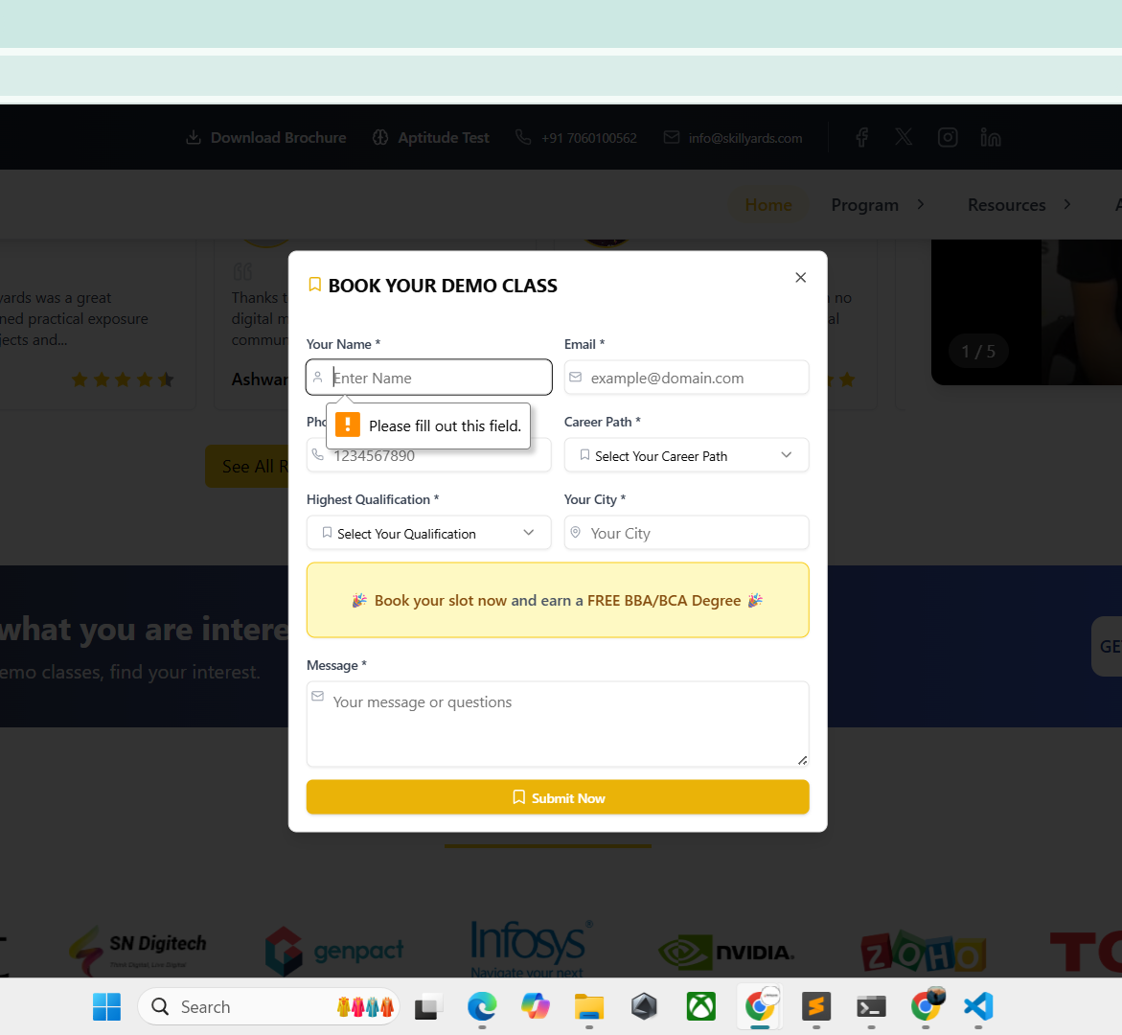
Real-world examples:
Form validation (e.g., checking if a password is strong).
Dynamic content updates (e.g., loading new tweets without refreshing).
Interactive games or animations.

Slide 5
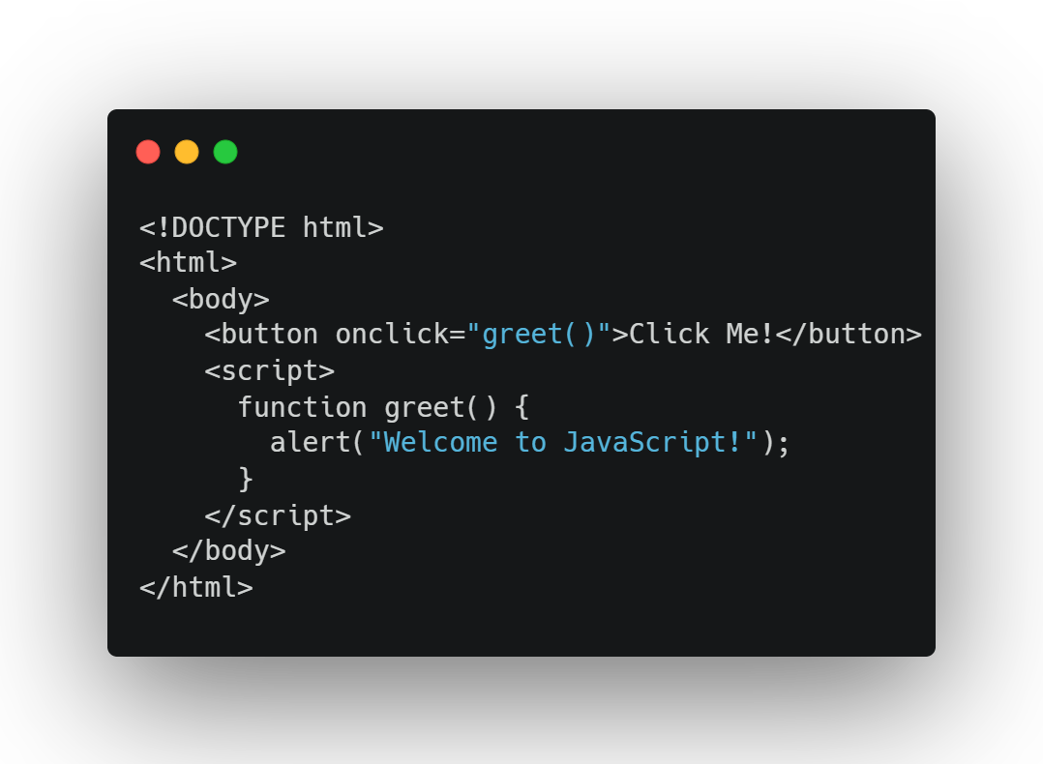
JavaScript in Web Development
Embedded in HTML using <script> tags or linked via external .js files.
Interacts with the Document Object Model (DOM) to manipulate webpage elements.

Slide 6
JavaScript in Web Development
Embedded in HTML using <script> tags or linked via external .js files.
Interacts with the Document Object Model (DOM) to manipulate webpage elements.
Executed by the browser’s JavaScript engine (e.g., V8 in Chrome, SpiderMonkey in Firefox).
Can also handle events (e.g., clicks, keypresses) and fetch data from servers.

Slide 7

Variables: var, let, and const
What are Variables?
Containers for storing data (e.g., numbers, text, true/false values).
Analogy: Labeled boxes where you store items to use later in your code.
Declared using keywords: var, let, or const.

Slide 8
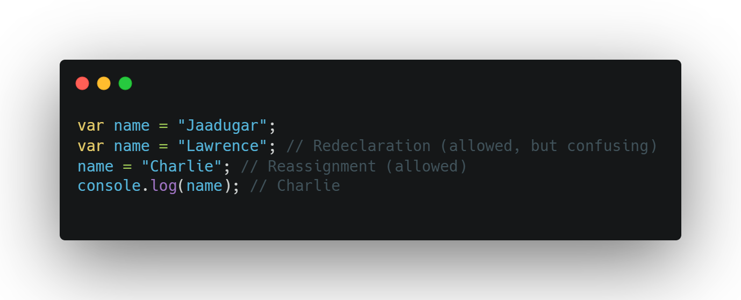
var
Legacy keyword (pre-ES6), function-scoped or global-scoped.
Allows redeclaration and reassignment.
Prone to bugs due to hoisting and lack of block scope.

Slide 9
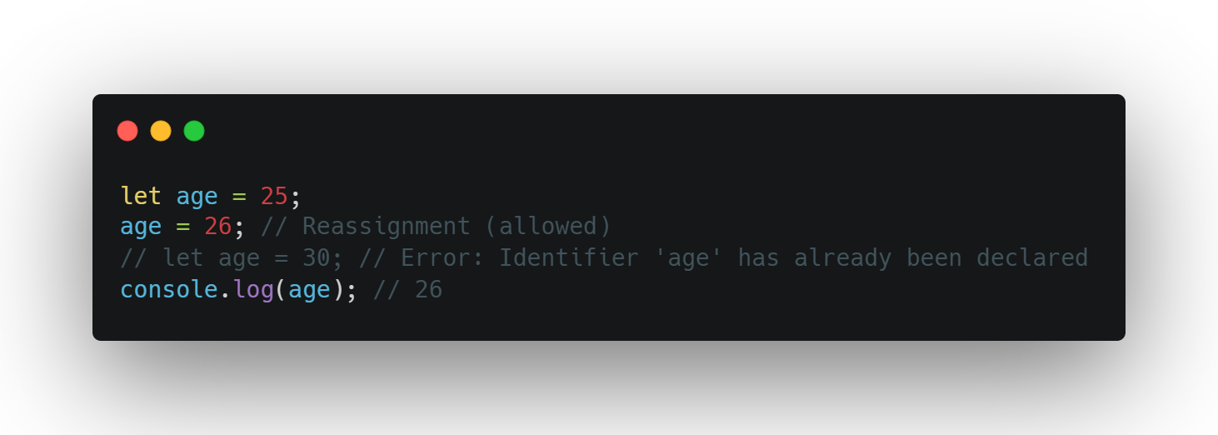
let
Introduced in ES6, block-scoped (more on scope later).
Allows reassignment but not redeclaration in the same scope.
Preferred for variables that may change.

Slide 10
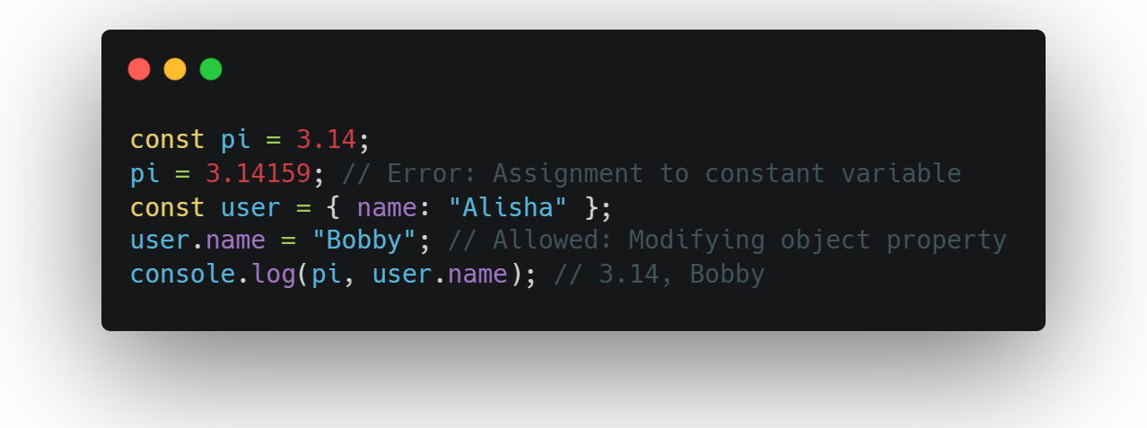
const
Block-scoped, cannot be reassigned or redeclared.
Used for constants (values that won’t change).
Note: For objects or arrays, properties/elements can change, but the variable itself cannot be reassigned.

Slide 11

Naming Rules:
Must start with a letter, underscore (_), or dollar sign ($).
Can include letters, numbers, _, or $.
Case-sensitive (e.g., Name ≠ name).
Use descriptive, camelCase names (e.g., userName, totalPrice).
Reserved words (e.g., let, function) cannot be used.

Slide 12

Variable Scope
What is Scope?
Determines where a variable is accessible in your code.
Types of scope:
Global Scope: Variables declared outside functions/blocks, accessible everywhere.
Local Scope: Variables declared inside functions or blocks, accessible only within.
Function Scope: Specific to var (and functions), variables are limited to the function.
Block Scope: Specific to let and const, variables are limited to {} blocks (e.g., in loops or if statements).

Slide 13
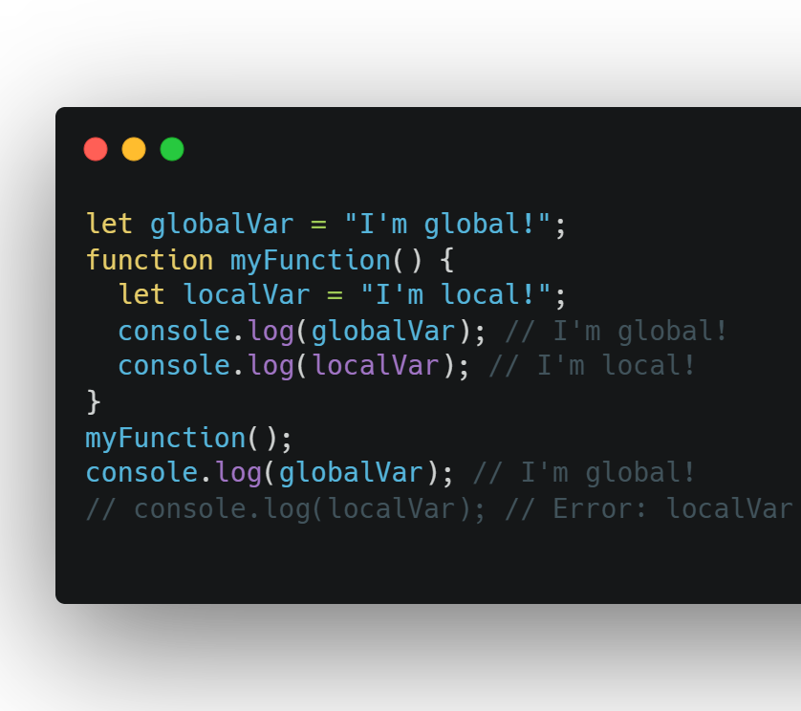
Global vs. Local Scope:

Slide 14
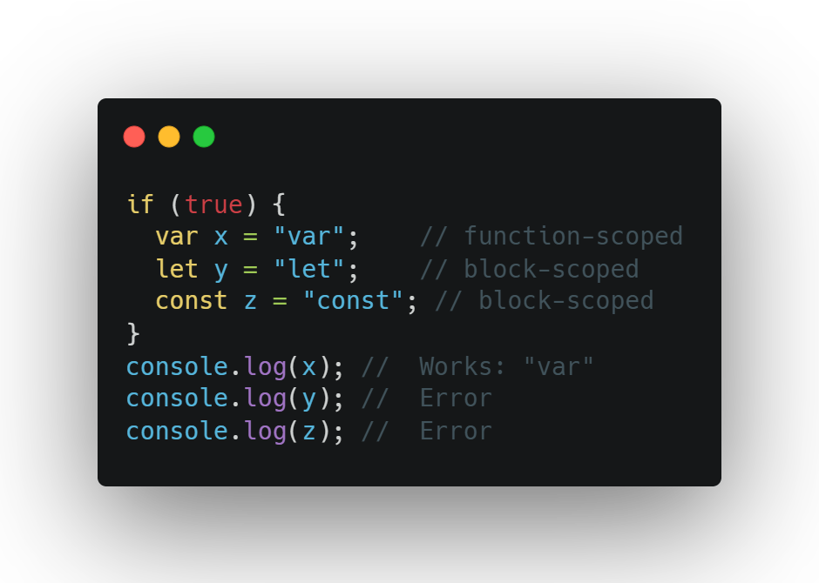
var vs let vs const

Slide 15
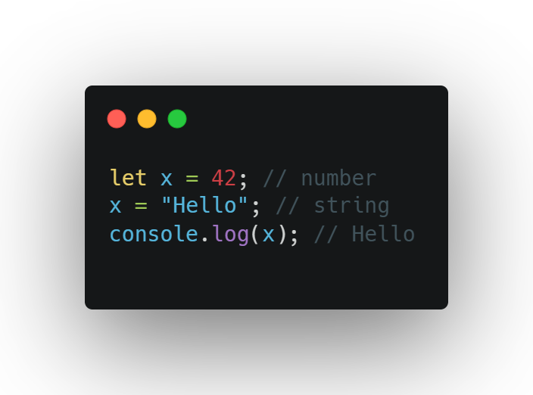
Data Types
JavaScript’s Dynamic Typing:
No need to specify variable types; types are determined at runtime.
Variables can change types during execution.

Slide 16
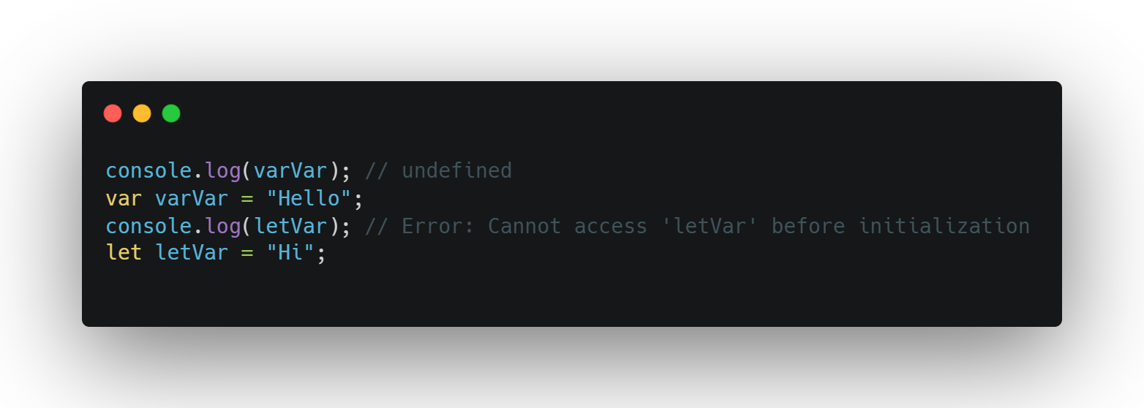
Hoisting:
var declarations (and function declarations) are hoisted to the top of their scope but initialized as undefined.
let and const are hoisted but not initialized

Slide 17

Key Takeaways
Use let and const to avoid scoping issues with var.
Be cautious of variable shadowing (same name in different scopes).
Always declare variables at the top of their scope for clarity.

Slide 18
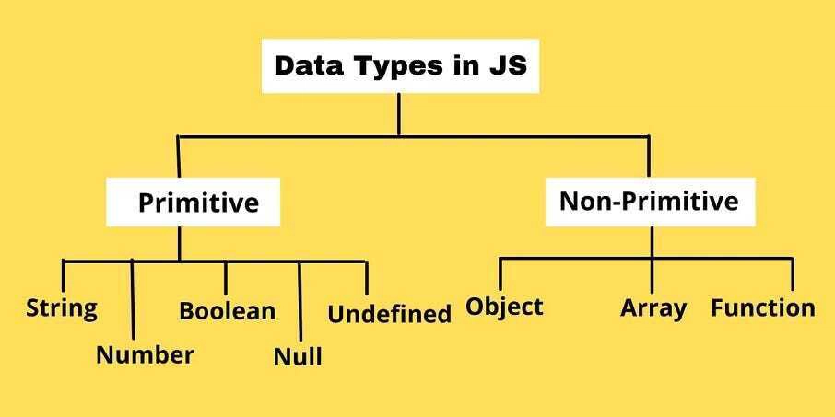

Slide 19
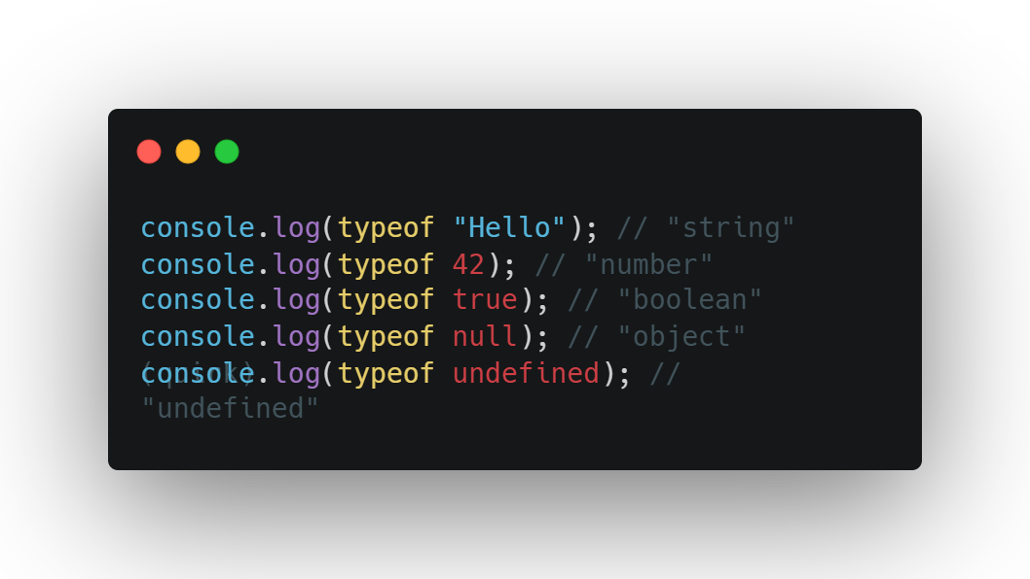
Checking Types with typeof:
Returns a string indicating the type of a value.

Slide 20
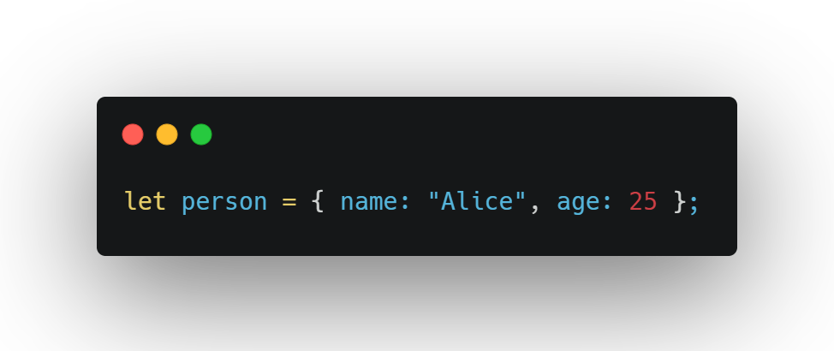
Other Data Types
Object: Complex data type for key-value pairs (will be covered later).

Slide 21
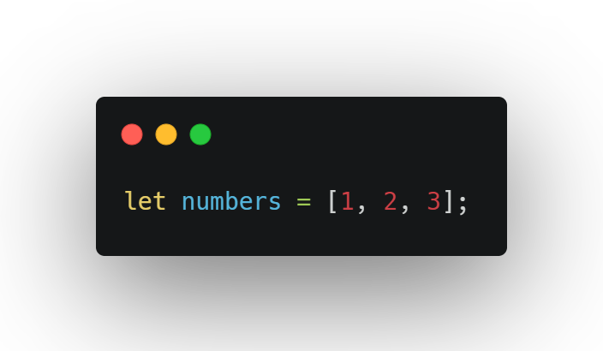
Other Data Types
Array: Ordered list of values (will be covered later).

Slide 22
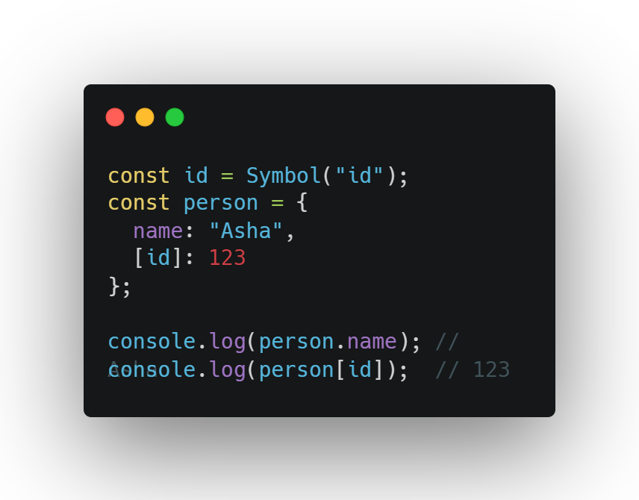
Other Data Types
Symbol: Even if two symbols have the same description, they're totally unique

Slide 23
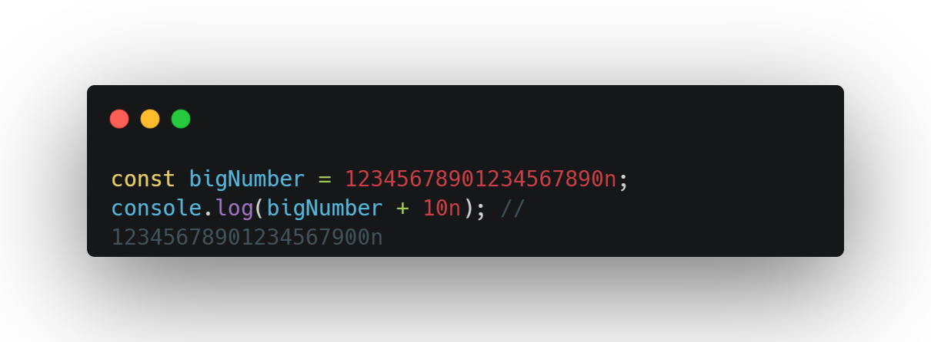
Other Data Types
BigInt: For large integers beyond Number’s safe limit (advanced).

Slide 24

Common Operations

Slide 25
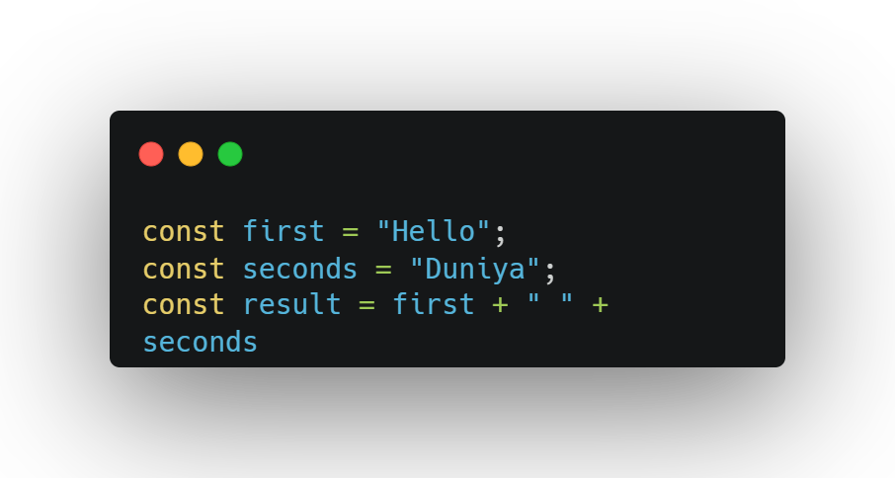
Concatenation

Slide 26
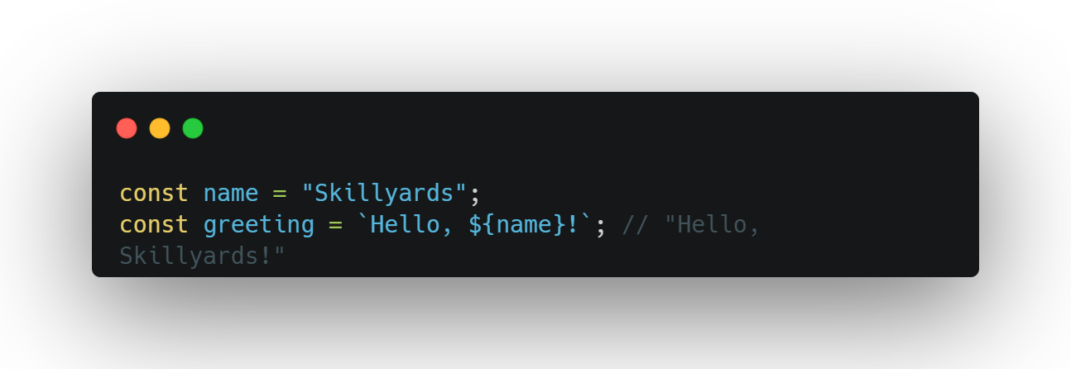
Interpolation

Slide 27
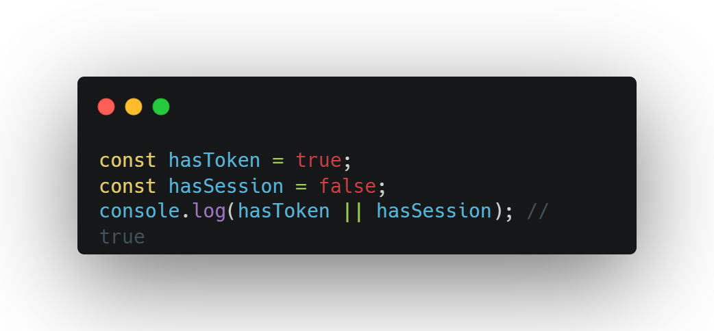
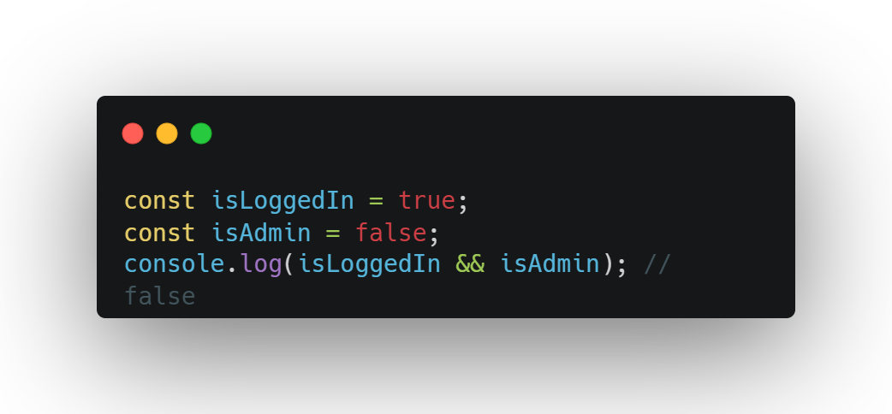
Booleans

Slide 28
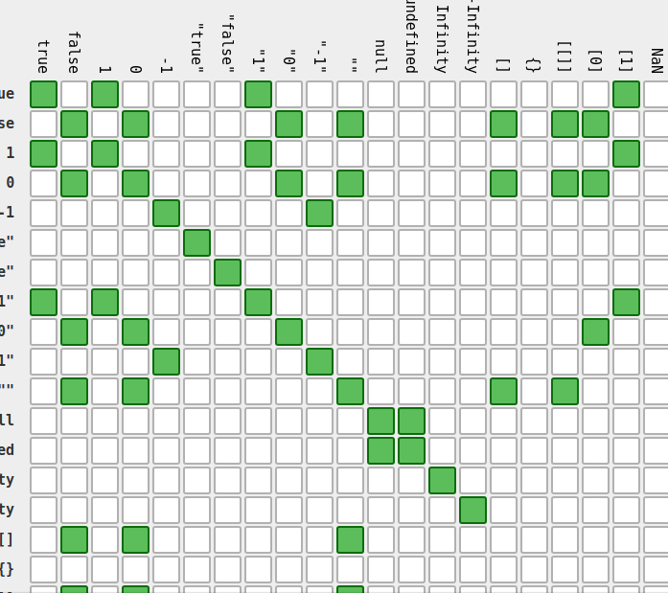
Type Coercion
JavaScript’s automatic conversion of one data type to another during operations.
Can be implicit (automatic) or explicit (manual).
Often occurs with operators like +, , , /, ==, or in logical contexts.

Slide 29
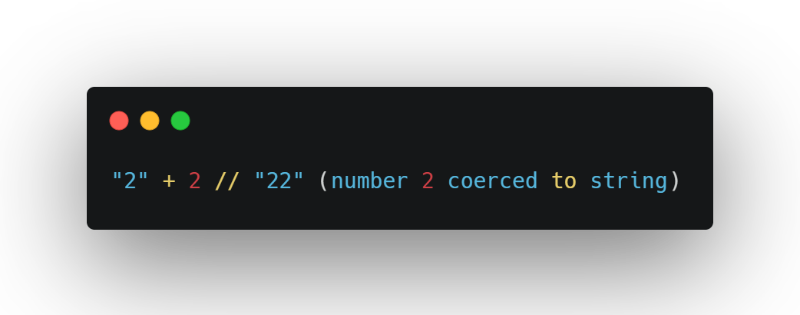
Implicit Coercion:
String Coercion: When a non-string is combined with a string (e.g., using +).

Slide 30
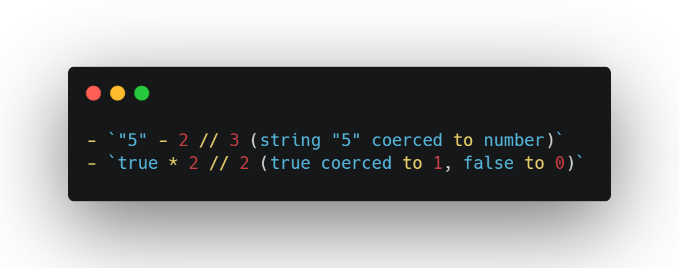
Implicit Coercion:
Number Coercion: When strings or booleans are used in arithmetic (except + with strings).

Slide 31
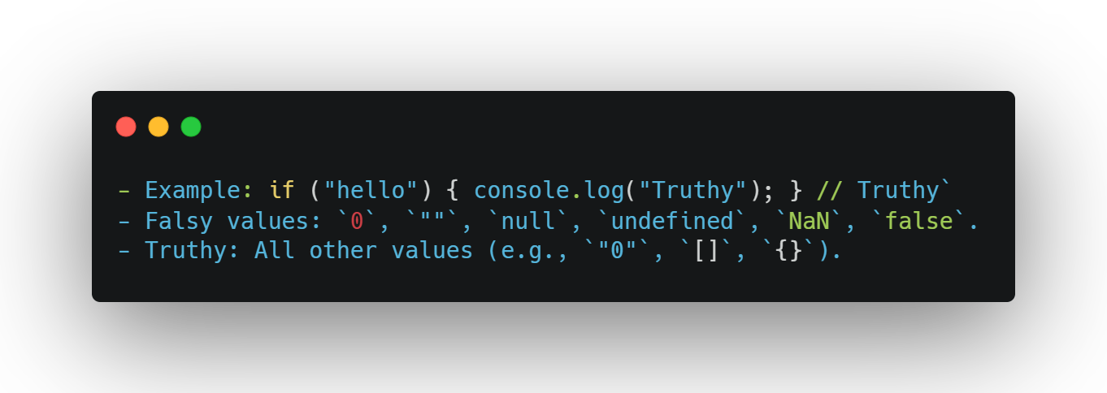
Implicit Coercion:
Boolean Coercion: n logical contexts (e.g., if statements).

Slide 32
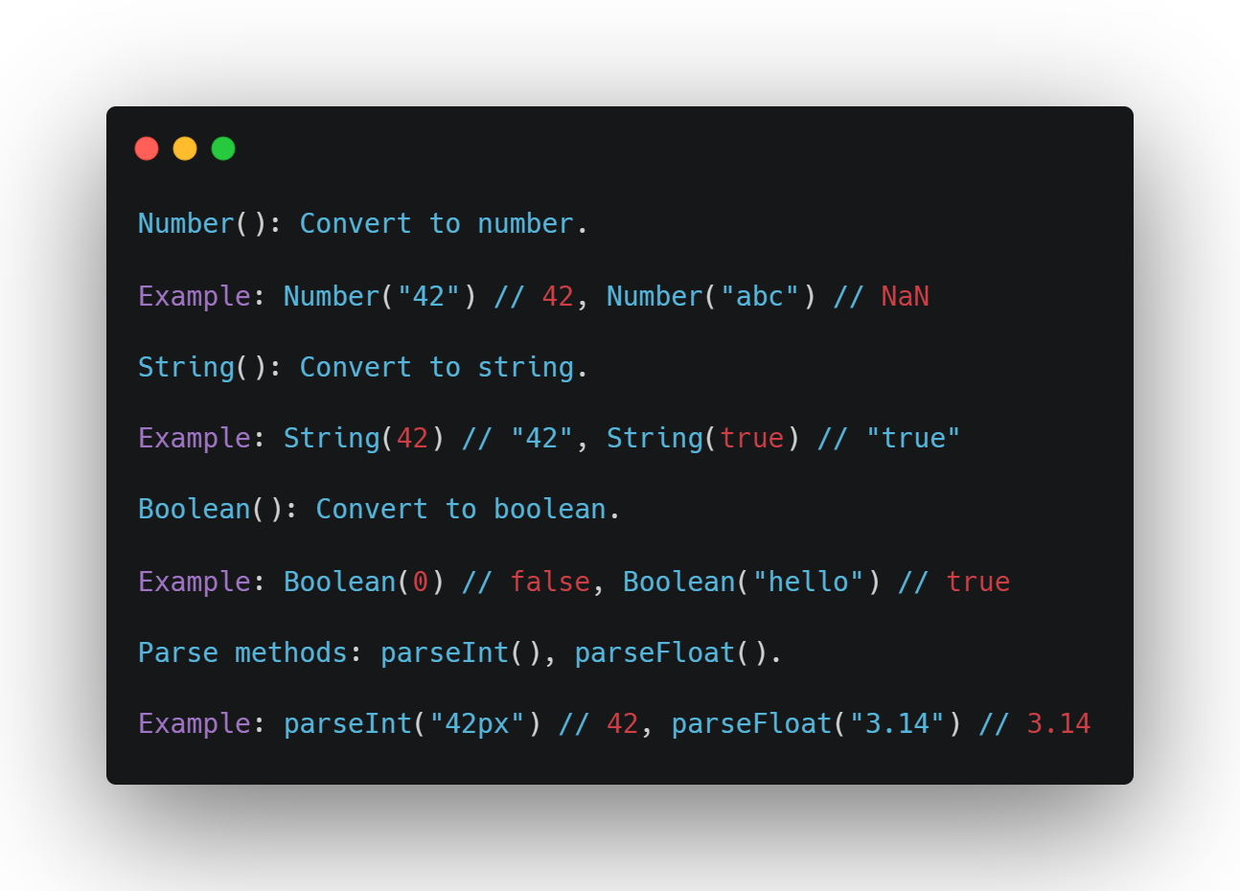
Explicit Coercion:
Use functions to manually convert types for predictability.

Slide 33

Exercise

Slide 34
Exercise 1: Declaring and Manipulating Variables
Declare variables:
A var for a city name (e.g., "New York").
A let for a temperature (e.g., 72).
A const for a country code (e.g., "US").
Reassign the let variable (e.g., change temperature to 68).
Try reassigning the const and observe the error.
Create a block (e.g., inside an if statement) and declare a let variable inside it. Try accessing it outside the block.
Log all variables and their types using console.log and typeof.

Slide 35
Exercise 2: Work with Data Types
Declare variables for each primitive type:
String: Your favorite food.
Number: Your current year (e.g., 2025).
Boolean: Whether you’re a student (e.g., true).
Null: An empty placeholder for a future value.
Undefined: A variable declared but not assigned.
Use console.log and typeof to display each variable’s value and type.
Perform one operation per type:
String: Concatenate with another string.
Number: Add 10 to it.
Boolean: Use in an if statement to log a message.
Null/Undefined: Compare with === to see the difference.

Slide 36
Exercise 3: Experimenting with Type Coercion
Perform and log the results of these operations:
"15" + 5 (string + number).
"20" - 5 (string - number).
true + 2 (boolean + number).
"4" * "3" (string * string).
"abc" + 1 (invalid string + number).
Use explicit coercion to ensure "15" + 5 results in numeric addition (20).
Compare 5 == "5" and 5 === "5". Explain the difference in the console.

Slide 37
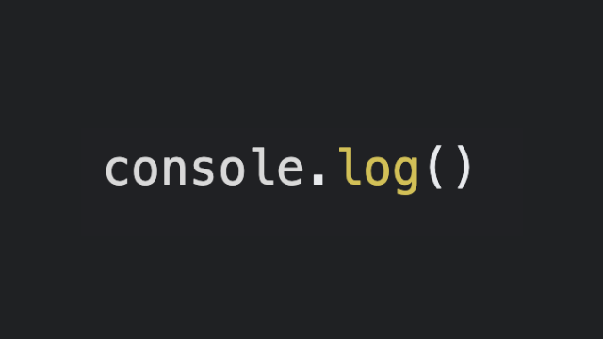
What is console.log?
A method to print values to the browser’s console (DevTools, F12).
Essential for debugging, inspecting variables, and understanding code flow.

Slide 38
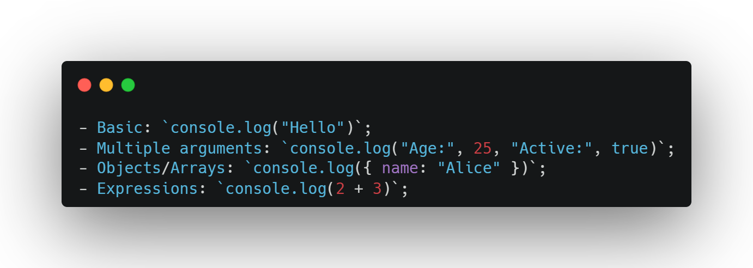
Syntax and Usage

Slide 39
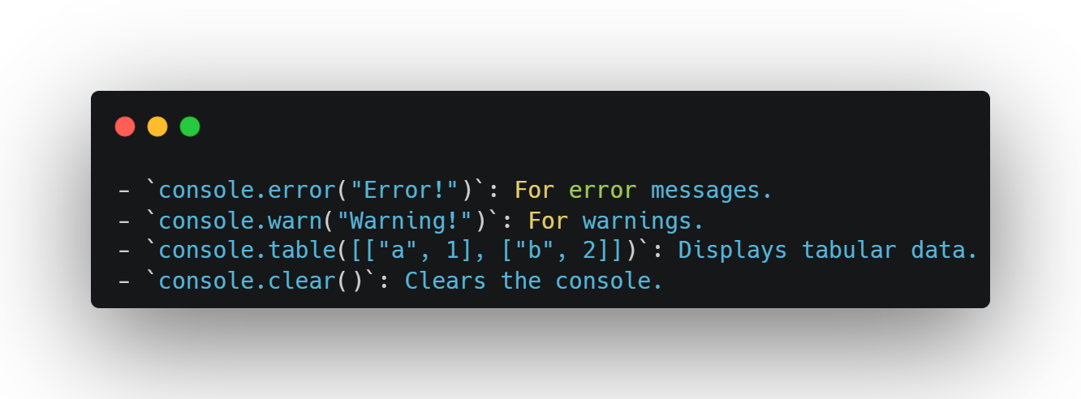
Other Console Methods

Slide 40


Slide 41

Recap...
JavaScript: Powers web interactivity, manipulates the DOM, runs in browsers.
Variables: Use const for constants, let for reassignable values, avoid var.
Scope: Global, local, block, and function scope; let/const are block-scoped.
Data Types: String, number, boolean, null, undefined; check with typeof.
Type Coercion: Implicit (automatic) vs. explicit (manual); use === and explicit conversion for clarity.

Slide 42

Thank-You !!!

